Slide 1

Text Image Deblurring
Speaker: Wang Yuzhen
Shanghai Advanced Research Institute

Slide 2
Outline
Introduction
Experiment
Discussion

Slide 3
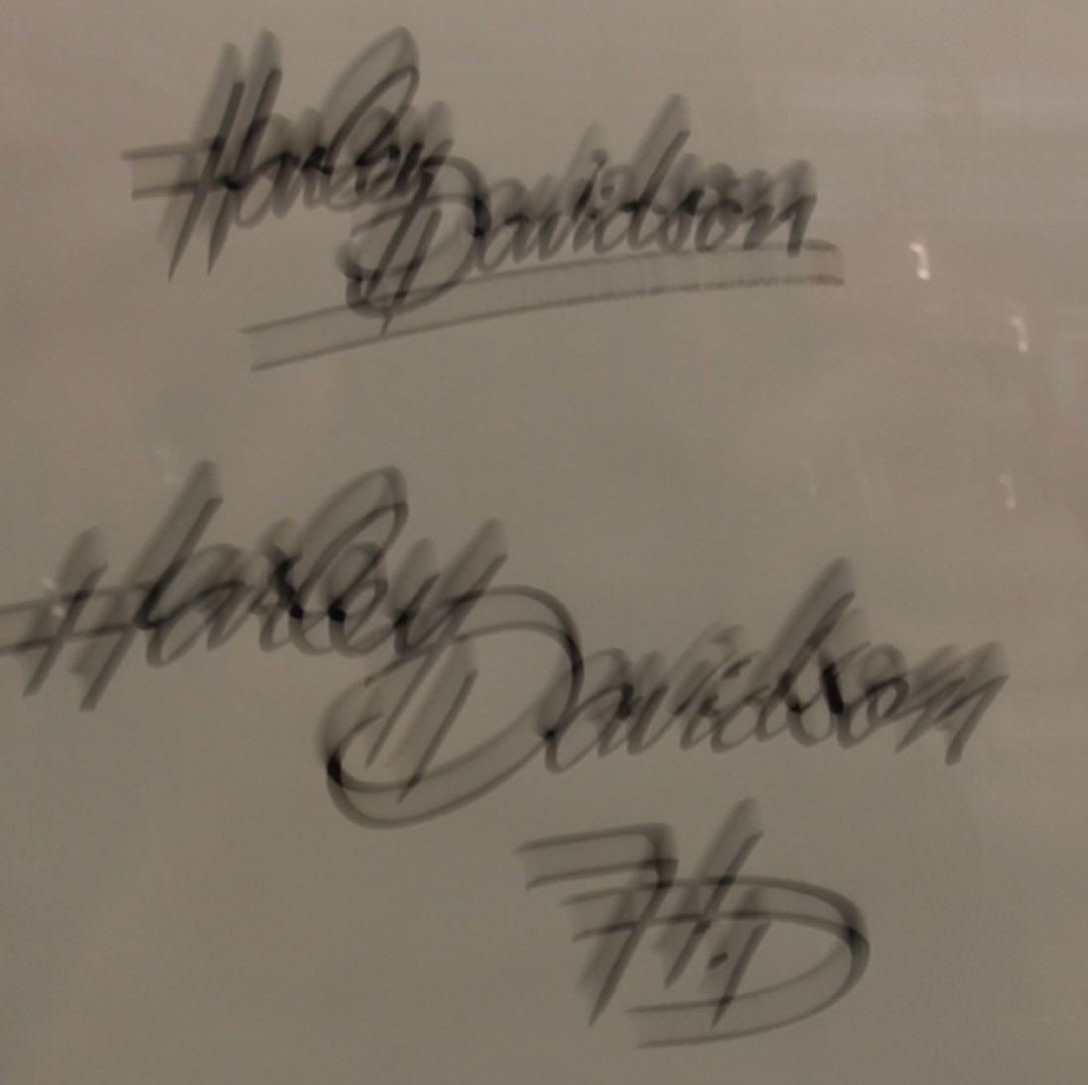
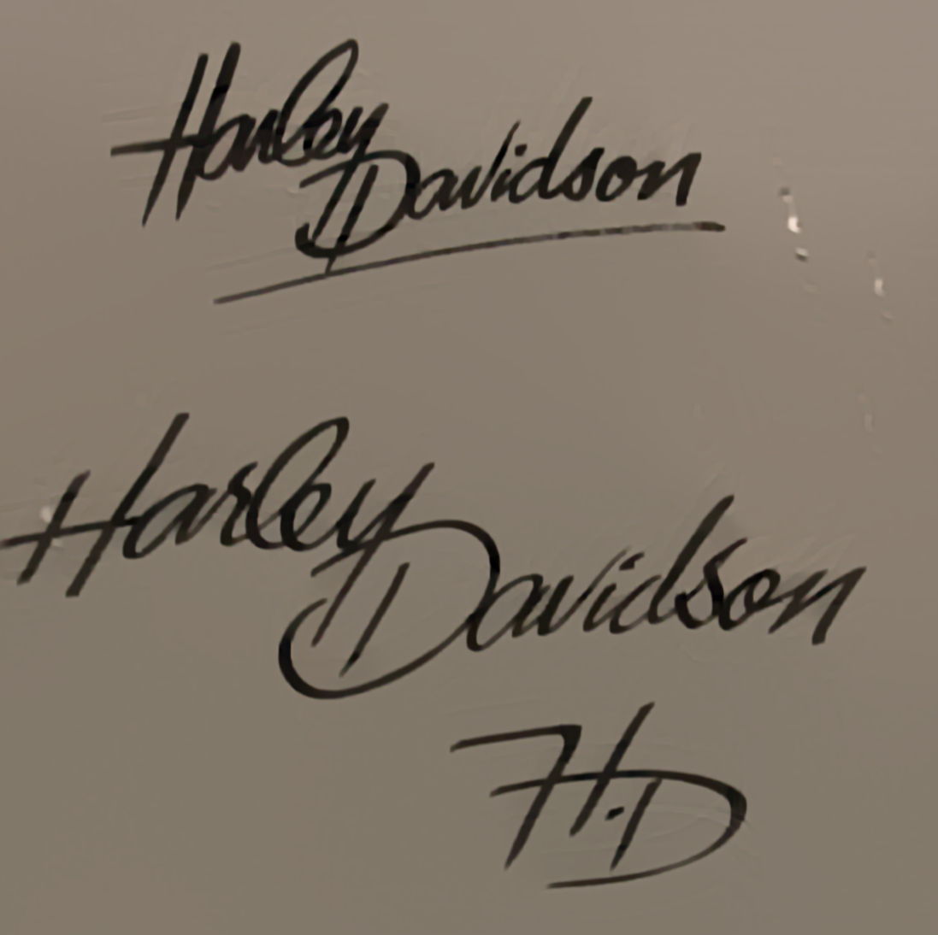


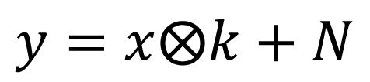
Blurry Image Formation Process
=
⊗
blur kernel
blurry image
latent sharp image
$$y=x⨂k+N$$
Model is approximation

Slide 4
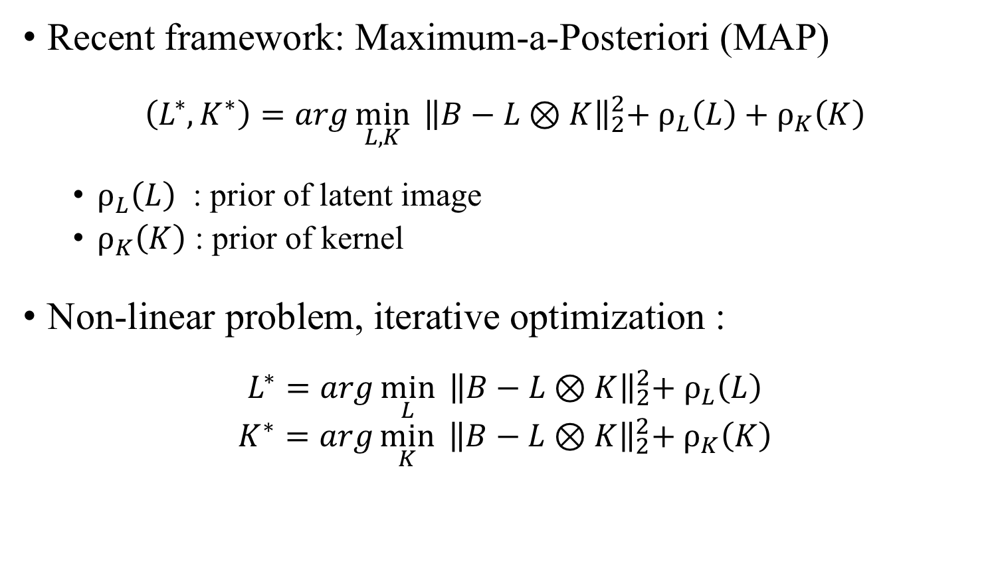
Common Framework
Recent framework: Maximum-a-Posteriori (MAP)
$$\left(L^{∗}, K^{∗}\right)=arg\min_{L, K}{{ \left\|B−L⊗K\right\|}_{2}^{2}+ ρ_{L}\left(L\right)+ρ_{K}\left(K\right)}$$
$ρ_{L}\left(L\right)$ : prior of latent image
$ρ_{K}\left(K\right)$ : prior of kernel
Non-linear problem, iterative optimization :
$$L^{∗}=arg\min_{L}{{ \left\|B−L⊗K\right\|}_{2}^{2}+ ρ_{L}\left(L\right)}$$
$$K^{∗}=arg\min_{K}{{ \left\|B−L⊗K\right\|}_{2}^{2}+ ρ_{K}\left(K\right)}$$

Slide 5
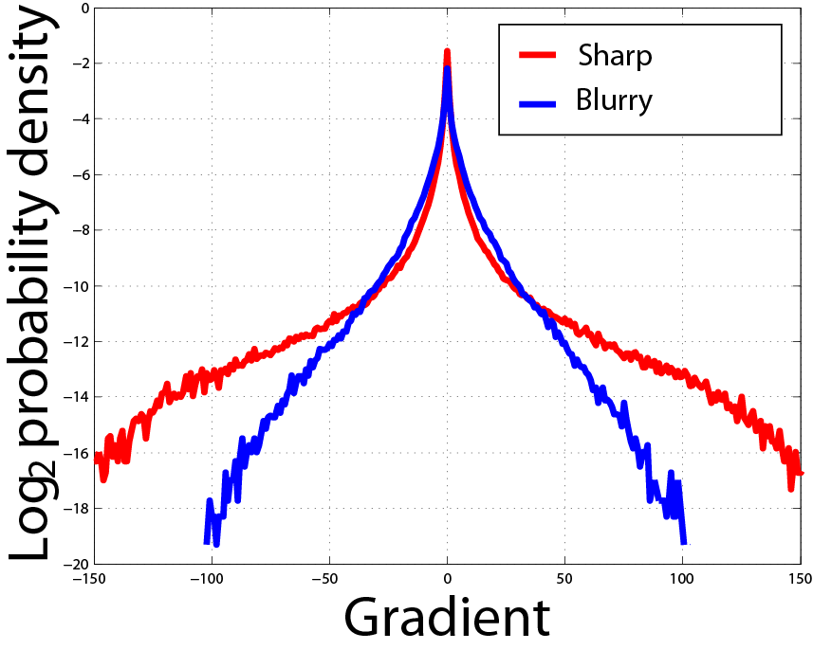
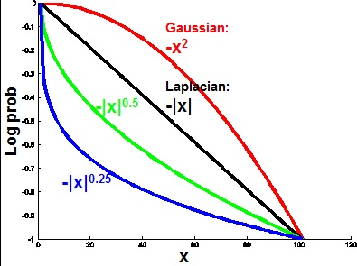
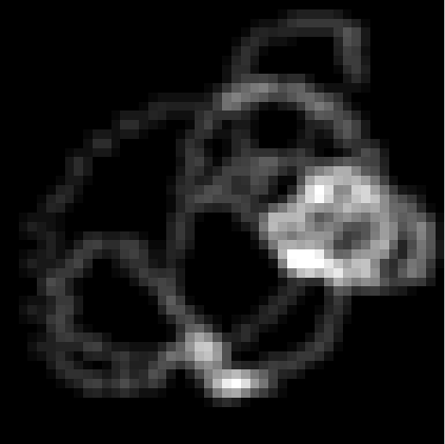
Image Statistics
heavy tails
regularization
positive & sparse
The properties of text images are different than those
of natural images. So Cho and Pan choose L0 norm.

Slide 6
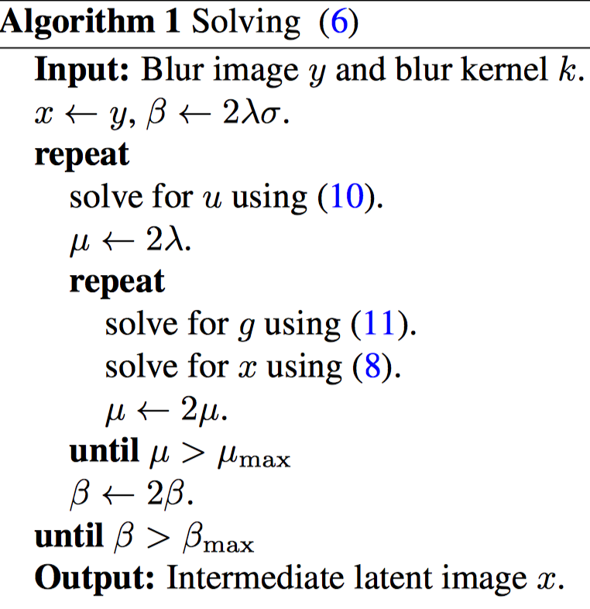
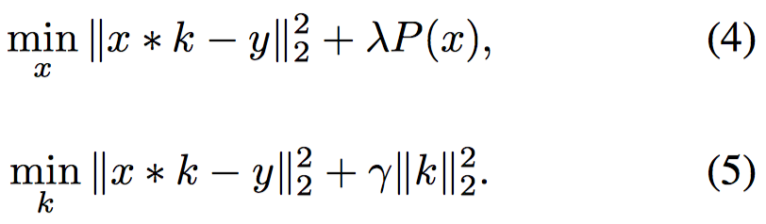
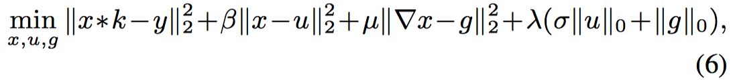
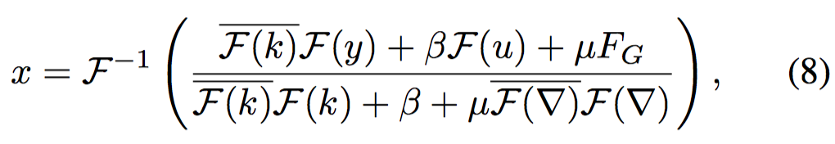
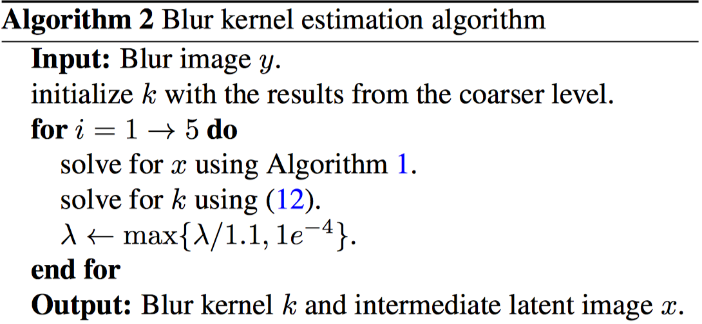
L0-Regularized Intensity and Gradient Prior
Deblurring Text Images via L0 -Regularized Intensity and Gradient Prior
Jinshan Pan et al. 2014 CVPR

Slide 7
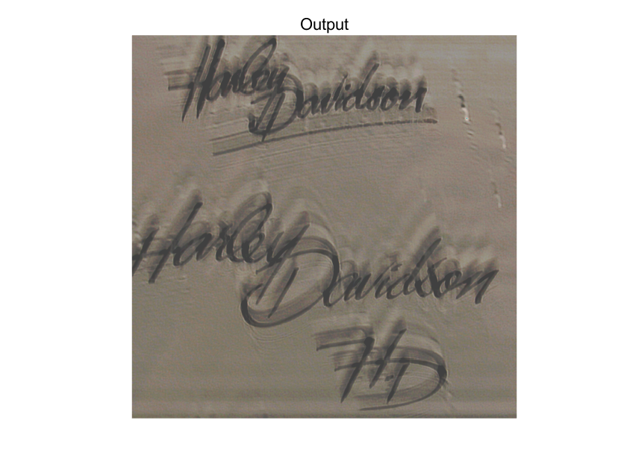
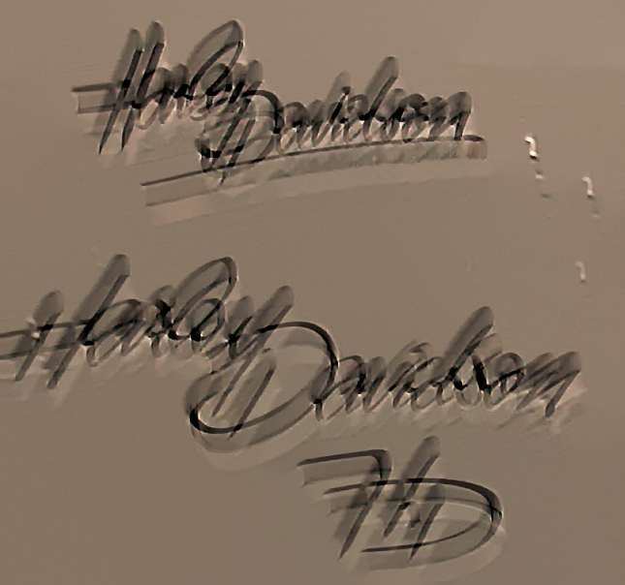
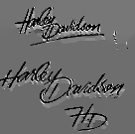
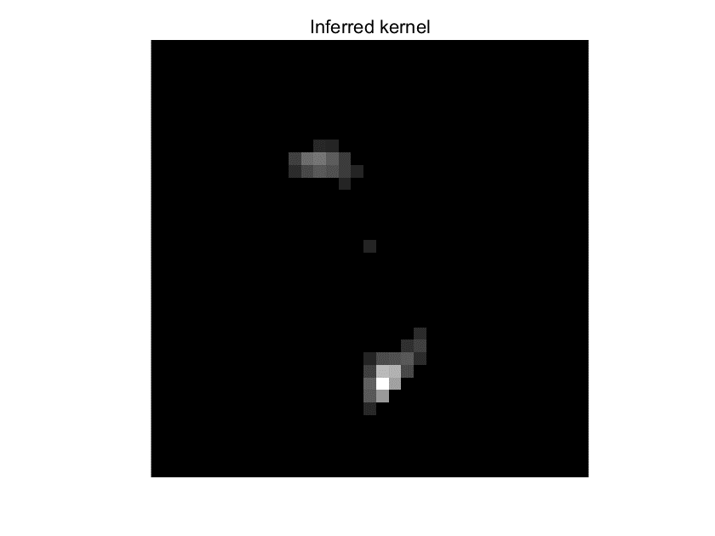

Experimental Results
Fergus et al. 2006 TOG
Pan et al. 2014 CVPR
Our result
85*85
85*85
17*17

Slide 8
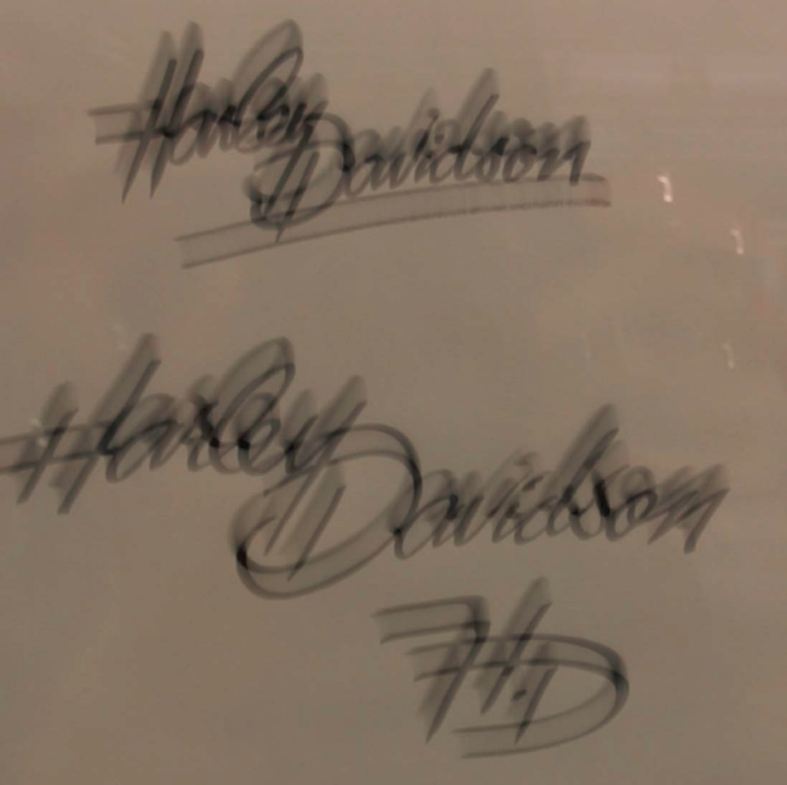
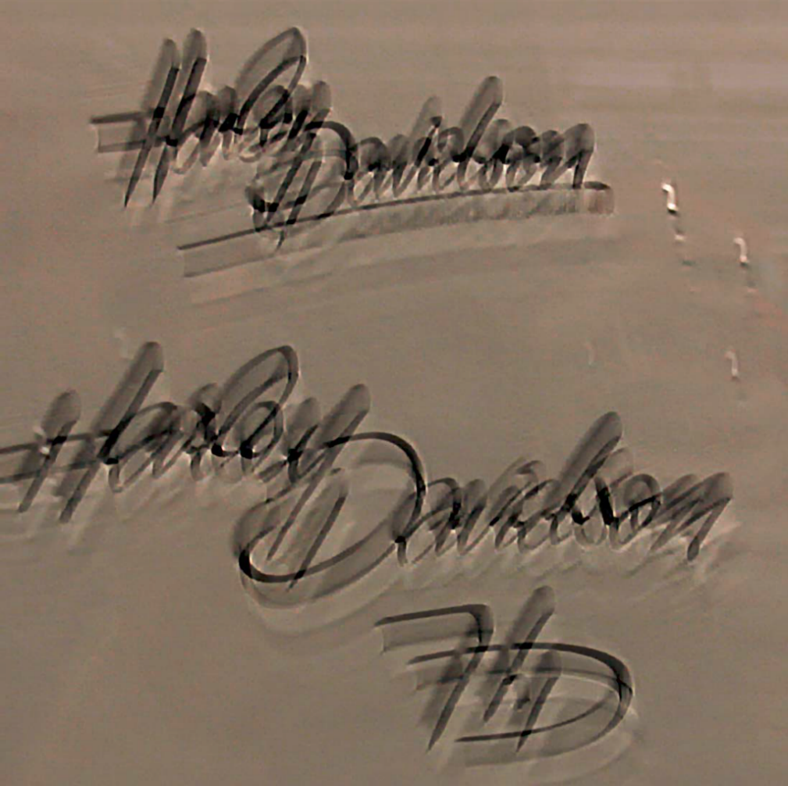
Analysis
Original image
Xu et al.
The right text image may has natural images’ and text images’ properties.

Slide 9
Thank You!

